Slide 1
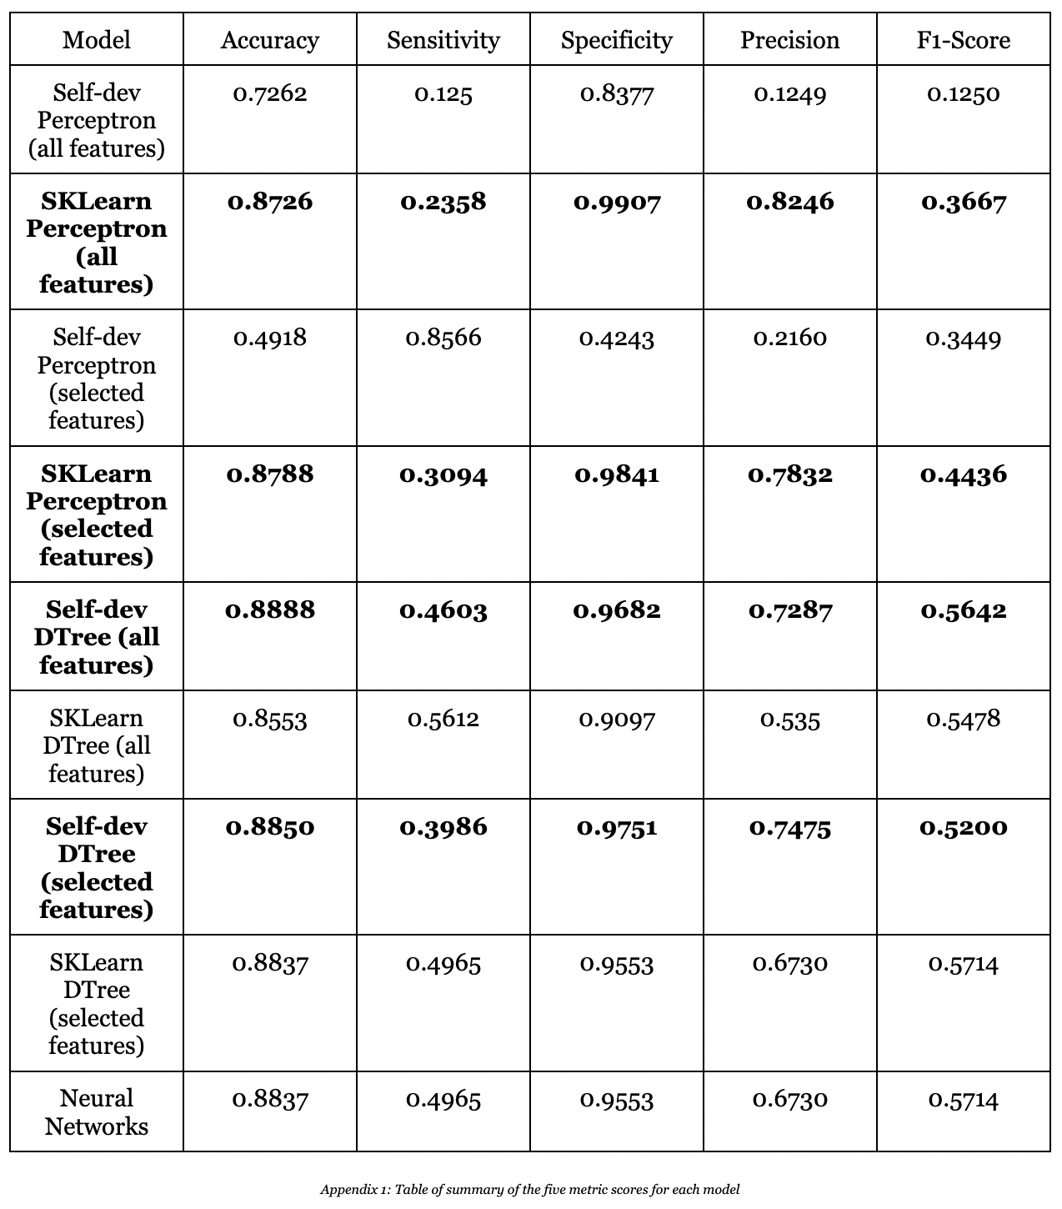
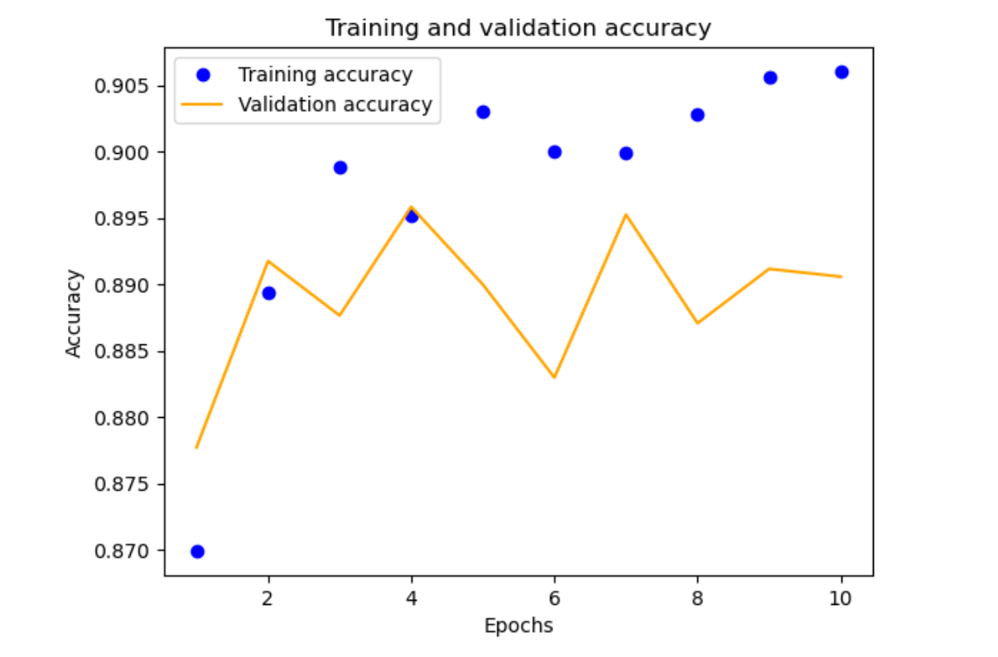
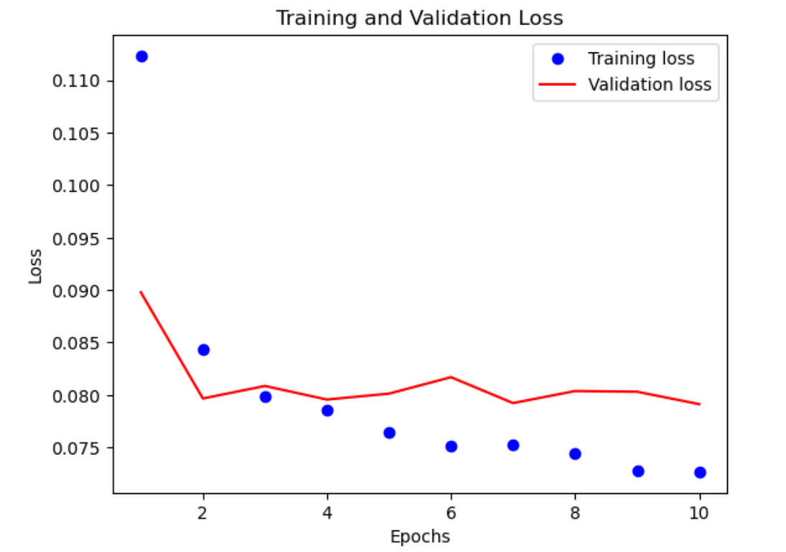
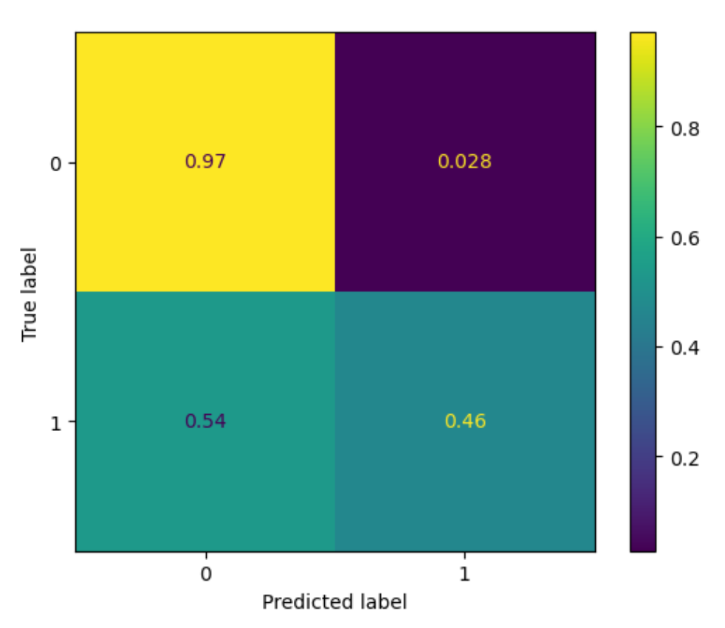
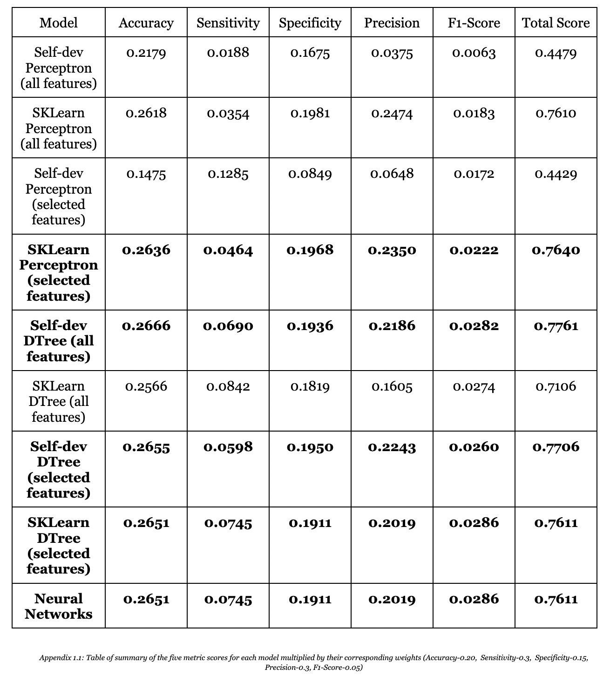
To Buy or Not To Buy
To Buy or Not To Buy
Predicting E-Commerce Shoppers’ Purchase Intentions
DS4400 || Luke Abbatessa, Jocelyn Ju, and Yuting Zheng
Abstract
This project was intended to determine whether an e-commerce shopper would ultimately make a purchase by taking into consideration a variety of factors including bounce rate, closeness to a special day, and visitor type. To accomplish this, we found machine learning classification algorithms that would perform the best for the data types and classification class values in the dataset. Using SciKit-Learn and self-developed machine learning algorithms for the perceptron model and decision tree algorithm with optimal feature selections, hyperparameter tuning, and cross-validation methods, e-commerce consumers are classified into buying or not buying based on their behaviors measured using the attribute values. Identifying major attribute values can help determine website features, advertisements, and user interface interactions that would attract consumers and positively influence their purchasing decisions. The best model found was our self-developed Decision Tree algorithm with all of the features.
Results (cont.)
Results
Both methods of feature selection determined that the four most valuable features were ProductRelated, ProductRelated_Duration, ExitRates, and PageValues. “Selected features” below refers to these four.
Perceptron Algorithms
Self-developed Model:
all features, alpha = 0.001, epochs = 1000
selected features, alpha = 0.001, epochs = 1000
SciKit-Learn Model:
all features
selected features
Decision Tree Algorithms
Self-developed Model:
all features, max_depth = 6, impurity = 0.0, min_instances =2
selected features, max_depth = 6, impurity = 0.0, min_instances = 2
SciKit-Learn Model:
all features, max_depth = 4, min_instances = 2
selected features, max_depth = 4, min_instances = 2
Neural Networks
TensorFlow Library, Sequential
activation criteria : relu
optimizer : Adam
all parameters (10,625) were trainable parameters
batch size = 2, verbose = 0, validation split = 0.2
MSE = 0.08, MAE = 0.152, RMSE = 0.421, TMAE = 0.249
A
B
C
Methods
Test-Train Split
Shuffled with SciKit-Learn’s train_test_split model
Feature Selection
Tree-based feature selection
Pipeline method
Machine Learning Models
Self-developed Perceptron Model vs. SciKit-Learn Perceptron Model
Self-developed Decision Tree vs. SciKit-Learn
Decision Tree
Neural Networks
Hyperparameter Tuning
SciKit-Learn GridSearchCV
Self-developed tuning algorithm
Cross-Validation Methods
10-fold cross validation
Conclusions
Findings:
Best Model: self-developed decision tree algorithm with all features
Hyperparameters: criterion- entropy, maximum depth- 4; minimum instances- 2; and 0.0 for target impurity
Caveats: skewed data, many more “False” values
Broader Context:
Potential for ML to be used across all sizes of businesses
Make more effective decisions for their business and customer bse
Potential for project to be used in immoral ways
Reflection:
Would implement hyperparameter tuning with the perceptron model ( alpha and epochs)
More neural network algorithms to compare with each other,
Take a sample from the original dataset representative of more equal proportions of “True” and “False” to alleviate data skewness
Determine an unbiased way to assign weights to the five metric scores to take into account the varying importances of the particular metrics
Try clustering the customers into specific groups based on similar behaviors
Objectives
Help E-Commerce businesses:
Identify customers who are not buying their products so they can develop marketing strategies to attract these customers into their customer base
Identify which aspects
of their websites are
attracting customers
Compare machine learning
methods to determine the
most effective approach to
achieving the above
objectives, incorporating
hyperparameter tuning
01
Perceptron
02
Decision Tree
PAY
References
“Ecommerce Machine Learning: Business Benefits + Use Cases.” BigCommerce, https://www.bigcommerce.com/articles/ecommerce/machine-learning/.
Galarnyk, Michael. “Understanding Train Test Split.” Built In, 28 July 2022, https://builtin.com/data-science/train-test-split.
Grant, Peter. “An Introduction to Bias-Variance Tradeoff.” Built In, 2 Dec. 2021, https://builtin.com/data-science/bias-variance-tradeoff.
Hashmi, Farukh. “How to Find Best Hyperparameters Using GridSearchCV in Python.”Thinking Neuron, Thinking Neuron, https://thinkingneuron.com/how-to-find-best- hyperparameters-using-gridsearchcv-in-python/
Jain, Vipin, et al. “An Overview of Electronic Commerce (e-Commerce).” Journal of Contemporary Issues in Business and Government, vol. 27, no. 3, 2021, https://doi.org/10.47750/cibg.2021.27.03.090.
Kumar, Manoj, et al. “Model-Based and Sequential Feature Selection.” Scikit-Learn, https://scikit-learn.org/stable/auto_examples/feature_selection/plot_select_from_model_diabetes.html#sphx-glr-auto-examples-feature-selection-plot-select-from-model-diabetes-py.
Sakar, C., and Yomi Kastro. “Online Shoppers Purchasing Intention Dataset.” UC Irvine Machine Learning Repository, UC Irvine, 30 Aug. 2018, https://archive-beta.ics.uci.edu/dataset/468/online+shoppers+purchasing+intention+dataset.
Zeglam. “Zeglam/Online-Shoppers-Intention-Prediction: Predict the Intention (Make a Purchase or Not) of e-Commerce Website Visitors.” GitHub, https://github.com/zeglam/Online- shoppers-intention-prediction.
03
Neural Network

